Slide 1
Annotation
A Powerful strategy
1

Slide 2
2
an· no· ta· tion
/anəˈtāSHən/
Noun:
A note by way of explanation or comment added to a text or diagram.
The action of annotating a text or diagram
Synonyms:
note - comment - gloss - remark - notation - commentary

Slide 3
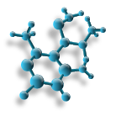
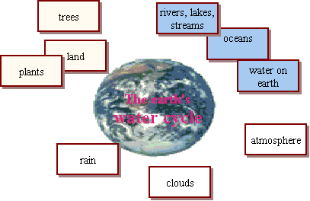
Annotation tips
3
Pay close attention to diagrams and other graphic organizers
Use colors, diagrams, arrows & symbols
when annotating
Underline, {bracket}, circle, asterisk*, and use
numerals and other symbols to
mark the text
Create simple concept maps of the
Information

Slide 4
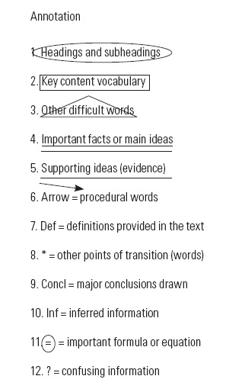

Slide 5
Put a circle around headings and subheadings—Headings and subheadings usually symbolize a major point of transition.
The headings and subheadings foreshadow what the next section is going to be about and show when the topic might be changing.
Headings and subheadings should be circled.
Put a rectangle around key content vocabulary—Key content vocabulary is essential to understanding the content of the reading.
Often these words may be bolded or italicized, but not always. These words should have a box drawn around them.

Slide 6
Put a triangle around other difficult or confusing words.
These words are up to the individual student to choose and there is no right or wrong answer.
Triangle as many words as necessary.
Notes:
Note to teachers: Sometimes students don't know a word when they see it written but will know it when they hear it

Slide 7
Use a double-underline for main ideas (claims) or important facts—The main idea is the most important concept from a particular section of a text.
It may be a single sentence, part of a sentence, or a combination of two or more sentences.
The main idea will tell you what the rest of the paragraph or section is about.
The main ideas may often relate to headings and subheadings that have been circled.
Notes:
Note to teachers: It is up to you to decide how you want students to find main ideas. Some teachers will ask for one main idea per paragraph, while others ask for one or two for each section. It is also best to ask students to double-underline one complete sentence in the beginning. As students advance you can ask them to find multiple phrases or sentences that make up the main idea. In some kinds of science text (e.g., physics) it is extremely difficult to find main ideas. In these instances it may be better to ask students to find important facts instead.

Slide 8
Use a single-underline for supporting ideas (evidence)—Supporting ideas should be single-underlined.
Supporting ideas back up the main idea and provide more information about the main idea.
Notes:
Note to teachers: Typically teachers will ask for a certain number of supporting ideas for each main idea (e.g., two or three).

Slide 9
Draw an arrow next to procedural words—A procedural word is any word that gives direction and asks the reader to complete a task (e.g., write, measure, pour, draw, create).
Procedural words are typically found within laboratory or activity instructions.
By pointing out procedural words, students will know when they need to do something. An arrow should be drawn next to or above any of these words.

Slide 10
Write def next to definitions within the text—Often in science textbooks, definitions for vocabulary words are provided within the text either preceding or following the word.
These definitions should be marked by writing def in the margin or space next to or above the definition.
Definitions may also be embedded in the text for other difficult words that are not bolded or part of the key content vocabulary for that lesson.

Slide 11
Put an asterisk next to transition words or phrases within the text—Similar to headings and subheadings, transitions note a change is occurring.
Transitions can be words (e.g., however, first) or they can be phrases (e.g., on the other hand, in 1944).
These transitions are signals indicating that something is about to change, like the subject, date, or condition. An asterisk should be drawn next to transitions.
Notes:
Although you may easily recognize transitions, your students probably will not. Often students get confused about what they have read because they missed an important transition.

Slide 12
Write concl next to any major conclusions—Conclusions are usually found at the end of a paragraph, section, or reading.
They often summarize a large portion of preceding text.
Not every text will have conclusions. Concl should be written next to or above any conclusions in the text.

Slide 13
Write inf next to inferred information—An inference is part of the text that assumes the reader already knows something or has already learned about a specific topic.
When an inference appears in the text, inf should be written in the margin or space next to or above it.
Notes:
Note to teachers: Students will struggle with this step. Keep in mind that you may have to point these out to students, particularly in the beginning

Slide 14
Put an equal sign with a circle around it next to important formulas or equations—All important equations or formulas should be labeled this way to help students to easily find information when answering questions or solving problems.

Slide 15
Put a question mark next to confusing information—A question mark should be drawn in the margin or space next to any sentence or paragraph that is confusing or unclear.
A question mark can also be placed anywhere there is a question about the text.
Notes:
Note to teachers: Encourage students to do this every time they read. You can then see where students are struggling and easily address questions.

Slide 16
16
8/1/17
Powers of Government
The United States has a special system of federal government. The states and the national government share power. The U.S. Constitution tells how power is shared. It provides the framework for organizing the government. ?
Notes:
Hand out a copy of National vs. State Government article. As a whole class, go through the steps of annotating the first paragraph.
Read the paragraph together and model how to annotate – brainstorm as a class: what is the topic? What are important points about the topic? Circle these in the paragraph and write on the sticky note the topic and details.
Then form groups to continue through the article.

Slide 17
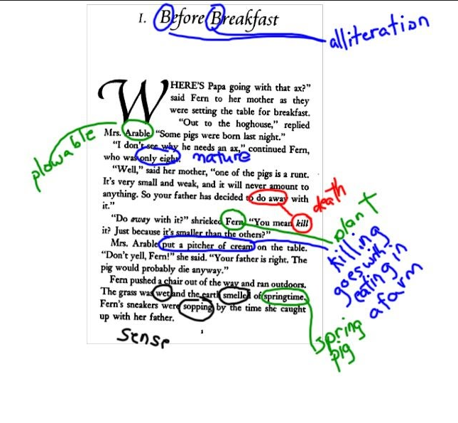

Slide 18
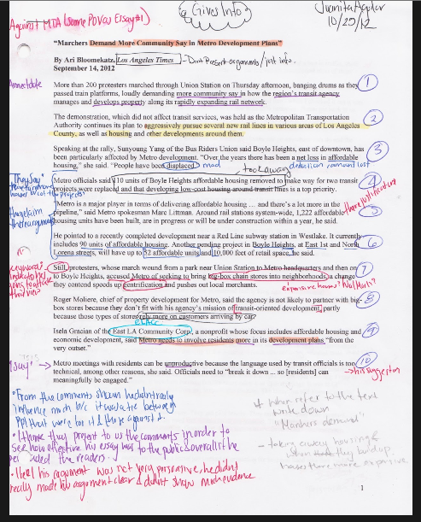

Slide 19
The United States has a special system of federal government. The states and the national government share power. The U.S. Constitution tells how power is shared. It provides the framework for organizing the government.
Federal Government
U.S. Constitution tells how states and
National government share power.
Subject of paragraph
What is important about the subject?
Sticky Note
19
Notes:
Presenters will model this annotation activity as workshop participants work through the strategy.

Slide 20
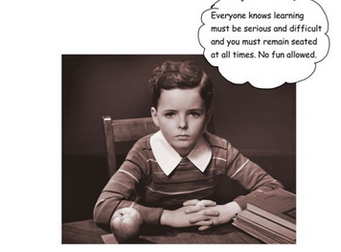

Slide 21
Penicillin Article

Slide 22
1 Can you imagine life with out penicillin? Prior to the 1940s, penicillin was not available to millions of Americans to treat infections caused by bacteria. Since its discovery in the mid-1940s,
penicillin has been an effective drug to cure often fatal diseases.
2 Sir Alexander Fleming discovered penicillin when he noticed mold growing in a lab dish containing common bacteria. He noticed that bacteria around the mold had died. That discovery led to the development of a small strain of penicillin which was used to treat patients with deadly infections. British scientists soon realized the power of the miracle drug.
.
.
22

Slide 23
23
The United States has a special system of federal government. The states and the national government share power. The U.S. Constitution tells how power is shared. It provides the framework for organizing the government.
Notes:
Hand out a copy of National vs. State Government article. As a whole class, go through the steps of annotating the first paragraph.
Read the paragraph together and model how to annotate – brainstorm as a class: what is the topic? What are important points about the topic? Circle these in the paragraph and write on the sticky note the topic and details.
Then form groups to continue through the article.

Slide 24
The United States has a special system of federal government. The states and the national government share power. The U.S. Constitution tells how power is shared. It provides the framework for organizing the government.
24
Federal Government
U.S. Constitution tells how states and
National government share power.
Subject of paragraph
What is important about he subject?
Sticky Note
Notes:
Presenters will model this annotation activity as workshop participants work through the strategy.

Slide 25
Continue to annotate the next 3 paragraphs in groups
25
Notes:
In groups, finish the government article and share process with the class. Depending on time, do a journal entry or HWA discussing the group activity.
Then, proceed to the Penicillin article as another example showing annotation as explained on page 163 of text.

Slide 26
Another Annotation Method
26
Importance of Penicillin
1 Can you imagine life with out penicillin? Prior to the 1940s, penicillin was not available to millions of Americans to treat infections caused by bacteria. + Since its discovery in the mid-1940s, - penicillin has been an effective drug to cure often fatal diseases. +
Sentence 1 main idea: Since the 1940s penicillin has been used an effective drug to treat bacterial infections and cure fatal diseases.
2 Sir Alexander Fleming discovered penicillin when he noticed mold growing in a lab dish containing common bacteria. He noticed that bacteria around the mold had died. That discovery led to the development of a small strain of penicillin which was used to treat patients with deadly infections. British scientists soon realized the power of the miracle drug.
3 Researchers discovered ways to produce large quantities of penicillin. This had a tremendous effect on medicine and led to the discovery of other antibiotics. Fleming and his associates were awarded the Nobel Peace Prize in Medicine for their work.
4 Penicillin has helped to treat many diseases such as syphilis, meningitis, and pneumonia. In addition, by eliminating the threat of bacterial infection during medical procedures, it has contributed to organ transplants and open heart surgery.
5 The discovery and development of penicillin is regarded as one of the greatest achievements in medical history. The world is a much healthier place to live since Sir Alexander Fleming’s discovery.
Notes:
Do each sentence, annotating as explained on page 163 of textbook. Use index cards to write down the main idea of each sentence.

Slide 27
Use Code to Analyze Passages
+ Means I knew that
- Means I didn’t know that
Notes:
The latest brain research has determined that for understanding and meaning to occur, new information must be connected to previously learned information. When this connection is made, comprehension occurs. By coding the text read, students are able to determine what they know and make this connection. Students should be helped to understand that they do not have to learn what they already know. They should concentrate on connecting the new information to the information that they already know. These are the patterns that facilitate comprehension.

Slide 28
(1)A loss leader is a product or service that sells at a loss but generates customer interest that can lead to a later profit. (2)A classic example of a loss leader is the ice-cream counter at a Thrifty’s variety store. (3)Ice cream cones are sold for less than the cost of the stand, equipment, supplies, and labor. (4)But the ice-cream counter, strategically placed near the store entrance, helps draw customers into the store. (5)Once inside, they often buy other items as well, so the store turns an overall profit. (6)The loss-leader principle is used in many other applications. (7)For instance, television networks take a loss on special events like the Olympic Games because they believe that the viewers they attract will then “stay tuned” for their other, moneymaking shows.

Slide 29
(1)A loss leader is a product or service that sells at a loss but generates customer interest that can lead to a later profit. (2)A classic example of a loss leader is the ice-cream counter at a Thrifty’s variety store. (3)Ice cream cones are sold for less than the cost of the stand, equipment, supplies, and labor. (4)But the ice-cream counter, strategically placed near the store entrance, helps draw customers into the store. (5)Once inside, they often buy other items as well, so the store turns an overall profit. (6)The loss-leader principle is used in many other applications. (7)For instance, television networks take a loss on special events like the Olympic Games because they believe that the viewers they attract will then “stay tuned” for their other, moneymaking shows.

Slide 30
ILLUSTRATION
The Definition and Example Pattern
Read the textbook paragraph below and then answer the questions.
(1)A loss leader is a product or service that sells at a loss but generates customer interest that can lead to a later profit. (2)A classic example of a loss leader is the ice-cream counter at a Thrifty’s variety store. (3)Ice cream cones are sold for less than the cost of the stand, equipment, supplies, and labor. (4)But the ice-cream counter, strategically placed near the store entrance, helps draw customers into the store. (5)Once inside, they often buy other items as well, so the store turns an overall profit. (6)The loss-leader principle is used in many other applications. (7)For instance, television networks take a loss on special events like the Olympic Games because they believe that the viewers they attract will then “stay tuned” for their other, moneymaking shows.
1. What term is being defined?
2. Which sentence contains the definition?
3. In which sentence does the first example appear?
4. In which sentence does the second example appear?
Notes:
See pages 233 and 234 in textbook.

Slide 31
ILLUSTRATION
The Definition and Example Pattern
Read the textbook paragraph below and then answer the questions.
(1)A loss leader is a product or service that sells at a loss but generates customer interest that can lead to a later profit. (2)A classic example of a loss leader is the ice-cream counter at a Thrifty’s variety store. (3)Ice cream cones are sold for less than the cost of the stand, equipment, supplies, and labor. (4)But the ice-cream counter, strategically placed near the store entrance, helps draw customers into the store. (5)Once inside, they often buy other items as well, so the store turns an overall profit. (6)The loss-leader principle is used in many other applications. (7)For instance, television networks take a loss on special events like the Olympic Games because they believe that the viewers they attract will then “stay tuned” for their other, moneymaking shows.
1. What term is being defined?
2. Which sentence contains the definition?
3. In which sentence does the first example appear?
4. In which sentence does the second example appear?
loss leader
sentence 1
sentence 2
sentence 7
Notice that each example is introduced by an illustration word.
Notes:
See pages 233 and 234 in textbook.

Slide 32
¹Stereotyping consists of assigning traits to people solely on the basis of a category. ²Some researchers suggest that stereotyping has four clear phases. ³First, a person distinguishes some category of people, for example, economists. ⁴Second, the person notes that one or more of the people in this category have certain traits, for example, dullness. ⁵Third, the person generalizes that everyone in this category has these characteristics, for example, that all economists are dull. ⁶Finally, when meeting someone the person is not acquainted with but knows to be, for example, an economist, the person stereotypes this individual as dull.
32

Slide 33
¹Stereotyping consists of assigning traits to people solely on the basis of a category. ²Some researchers suggest that stereotyping has four clear phases. ³First, a person distinguishes some category of people, for example, economists. ⁴Second, the person notes that one or more of the people in this category have certain traits, for example, dullness. ⁵Third, the person generalizes that everyone in this category has these characteristics, for example, that all economists are dull. ⁶Finally, when meeting someone the person is not acquainted with but knows to be, for example, an economist, the person stereotypes this individual as dull.
.
33

Slide 34
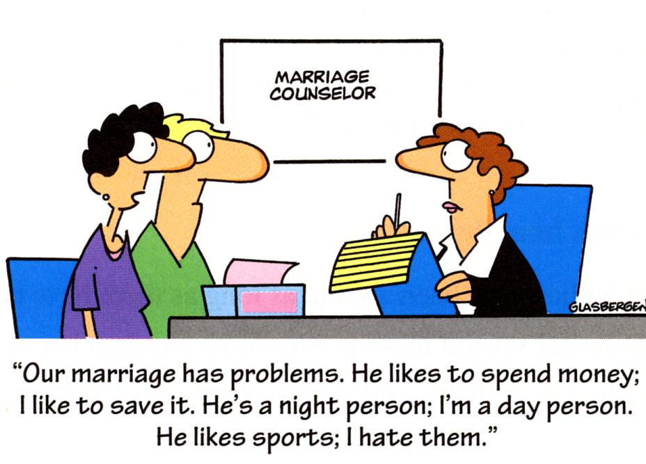
?
What’s the author’s point?
© Randy Glasbergen. www.glasbergen.com

Slide 35
Graphic Organizers – another effective annotation method
35

Slide 36
GRAPHIC (AND OTHER) ORGANIZERS
36
Text Concept Mind Mapping
Penicillin which was discovered by Fleming proved to be one of the greatest achievements in medical history.
Fleming discovers Penicillin
Who?
When?
Topic
What?
1940’s
Highly
effective drug
Details
A great achievement
In medical history
Kills bacteria
Treats many diseases

Slide 37
37
SCUBA

Slide 38
If you’re not writing, you’re not reading
Write on the document using the SCUBA method
Scan document for headings, images, footnotes, or interesting features
Circle words you don’t know, find and write the definitions in the margins
Underline key ideas
Box names, dates, places, and amounts
Annotate the author’s claims, different themes, summaries of paragraphs or sections, patterns/trends you notice, the author’s biases, and your reactions to what you’re reading
If you’re confused…
Re-read the last few sentences
Re-read the last few sentences out loud
Try explaining it to yourself out loud
Try explaining it to someone else out loud
38

Slide 39
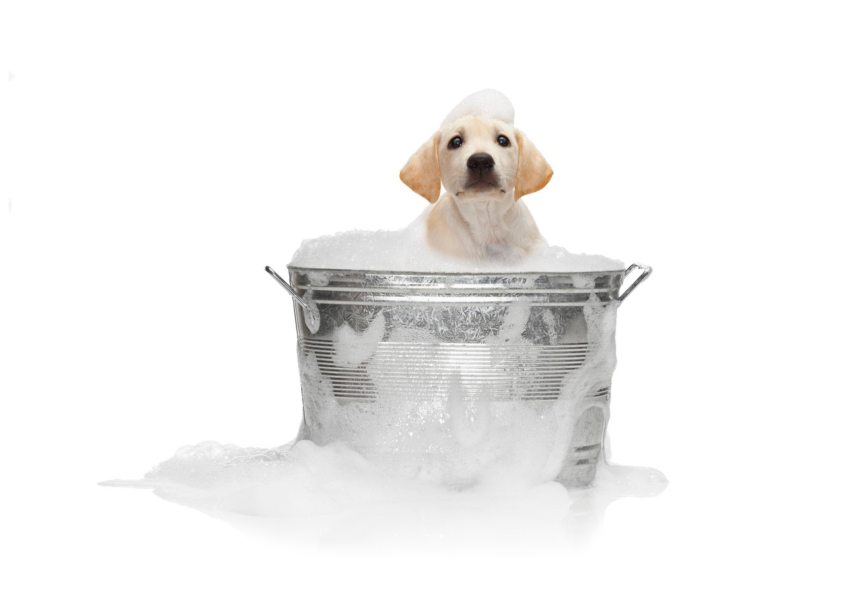
That’s All

Slide 40
Thank you! Iris Strunc
strunci@nwfsc.edu
850 729 6078

